Slide 1





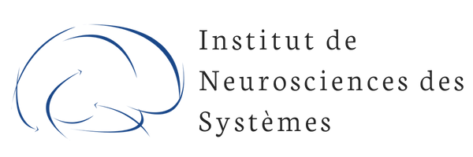

What is inference and How to make inference?
Meysam Hashemi
The Institut de Neurosciences des Systèmes (INS, UMR1106), Marseille, France

Slide 2

Content:
Definition of Inference
Optimisation problems
Identifiability (Sensitivity) Analysis
Probability Distribution
Bayesian inference
Bayesian vs Frequentist
State space modeling
Monte Carlo simulations and MCMC
Variational Inference (VI)
Free energy from different perspectives
Approximate Bayesian Computation (ABC)
Simulation-based Inference (SBI)
Applications on the data

Slide 3
What is inference?

Slide 4


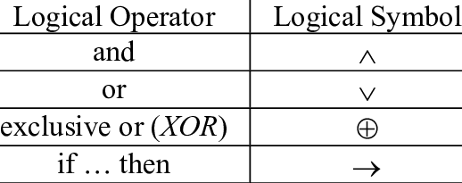
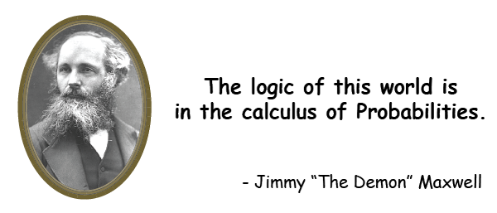
Inference:
The (top-down) process of drawing conclusions based on observation (available evidence or information)
Inference is the process of advancing from initial premises and observations to logical conclusions
by quantifying the uncertainty in a model and data, (using rules of logics, reasoning, algorithms, probabilities, …),
thus providing an objectification of the validity of the decision.
Inference
Premises (basis or proposition)
Conclusion (validity)
D’Angelo, Jirsa. Trends in Neurosciences 2022
Notes:
Premise: basis for a theory or statement or proposition in an argument
Forward models: Bottom-up: estimating the effects, knowing the causes
Model inversion: Top-down: estimating the causes, knowing the effects

Slide 5
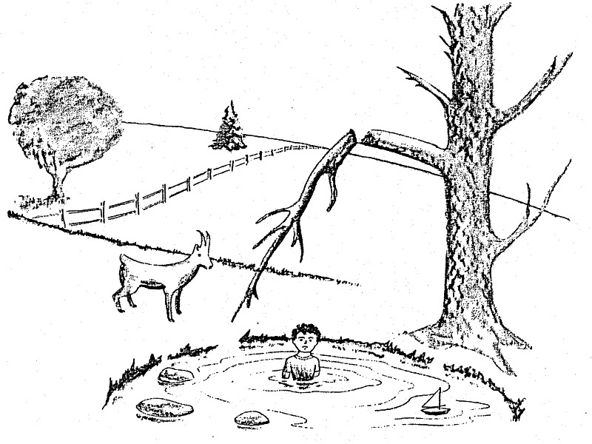
Observations vs. Inferences
An observation is something that you experience directly, but
an inference is a conclusion that is not explicitly stated, and involves making assumptions.
“The goat by the water”
Observations:
There is a kid is in the water.
There is a goat standing next to the water.
There is a broken tree branch.
Inferences:
The branch broke when the kid was sitting on it, and he fell into the water.
The goat butted the kid into the water when he was picking up his sailboat.

Slide 6
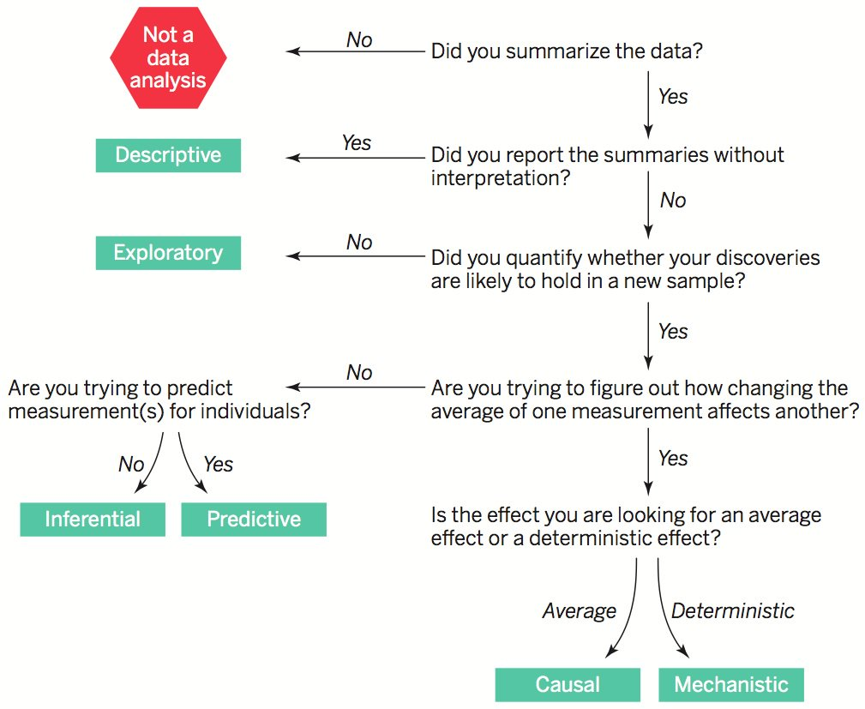


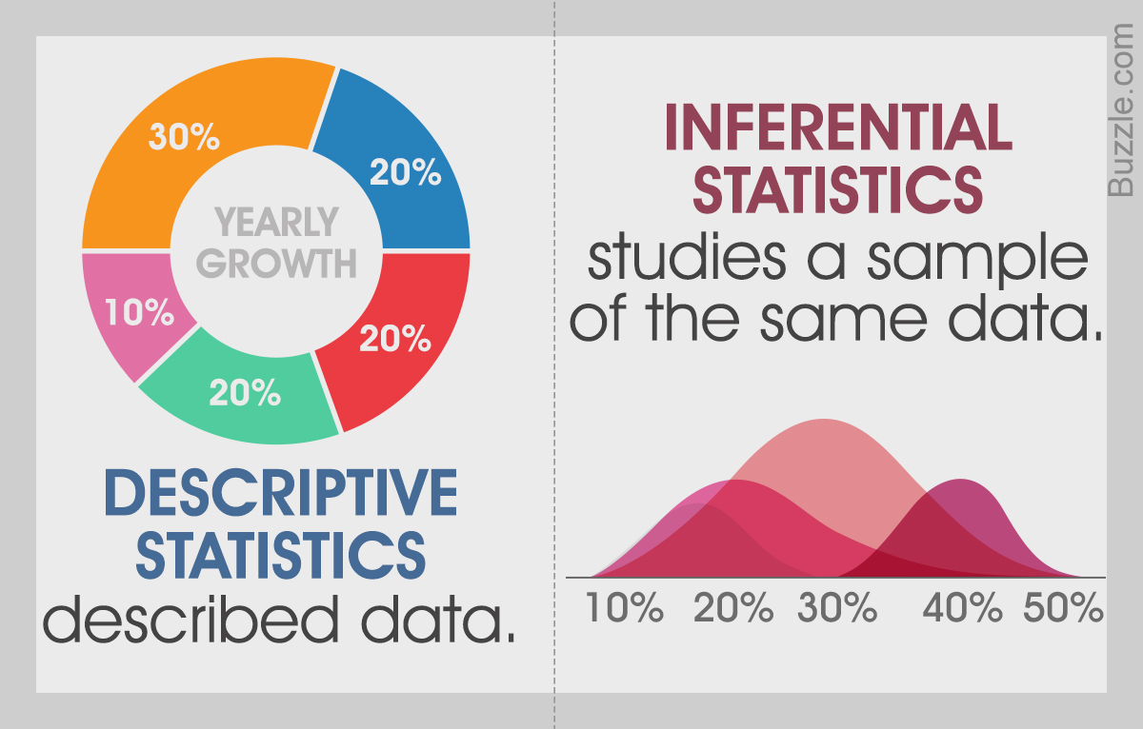
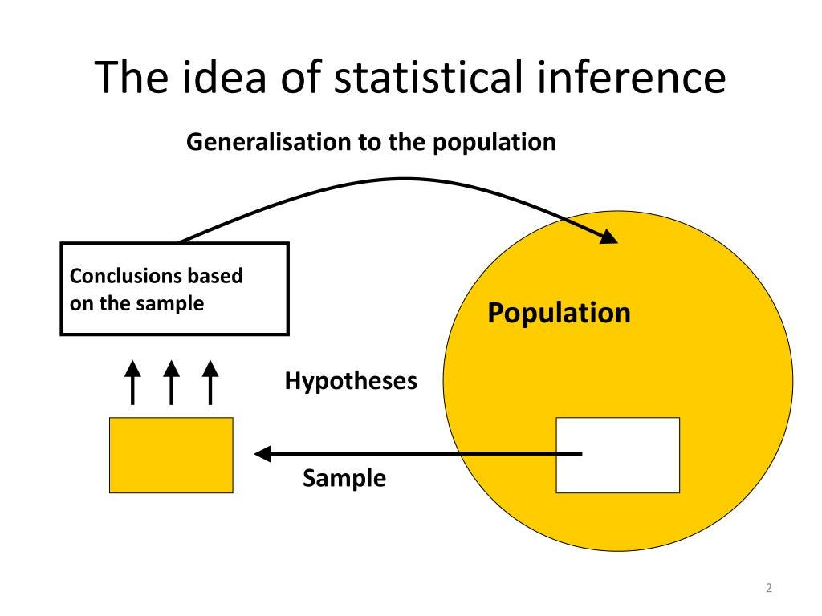
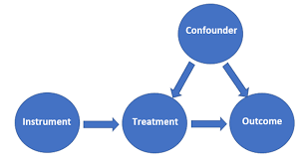
Here's how you can make inferences:
Collect Data
Analyze Data (visualisation, sensitivity analysis, PPC)
Identify Patterns and Relationships (statistical inference)
Formulate Hypotheses (causal hypothesis)
Run an Inference Method (MCMC, AI/ML)
Test the Inferences results (monitor convergence & validity)
Exploratory
Inferential statistics
Establishing
cause-and-effect
relationships
Notes:
Descriptive Inference: Describing the current state or characteristics of a situation based on data (summary presentation of data). For example, inferring the average age of a population from a sample of survey responses.
Inferential statistics is a way of making inferences about populations based on samples.
Inferential Inference: Testing statement or making generalizations (predictions) about a larger population based on data from a representative sample. This is common in statistics.
Predictive Inference: Making predictions about future events or outcomes based on historical or current data (individualised). For example, forecasting sales for the next quarter based on past sales data. This is common in machine learning.
Causal Inference: Determining cause-and-effect relationships between variables. Establishing causation often requires controlled experiments.

Slide 7
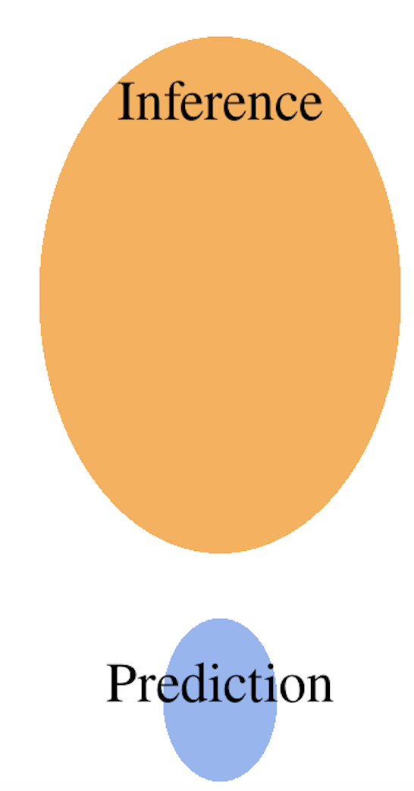
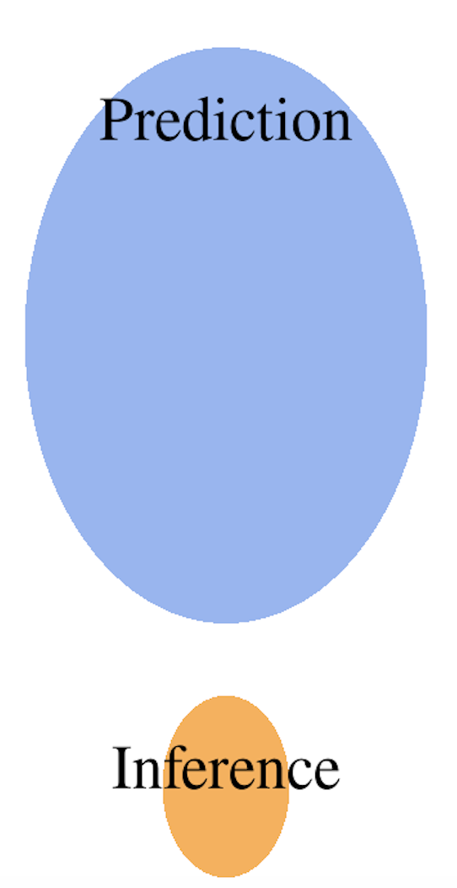


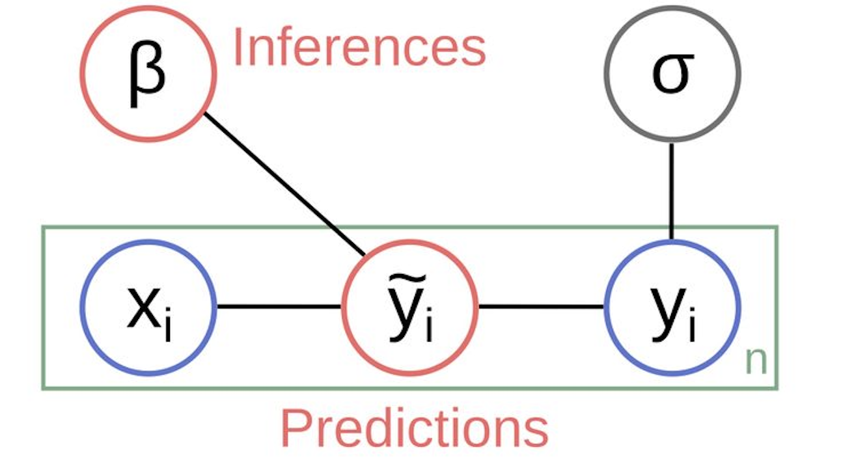
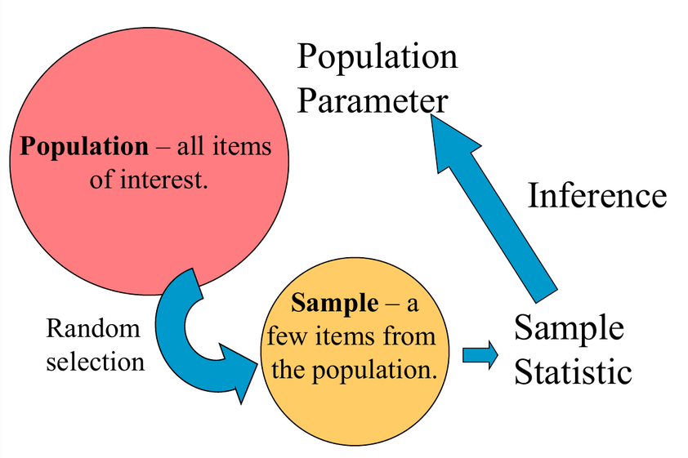

Inference is related to the past, prediction to the future
Statistics
Machine learning
Inference is generalising from samples to population with calculated uncertainty (available data).
Prediction is when we use the model to make predictions in the future (unseen data).
Prediction: An synthetic output emitted by a model in response to a specific configuration of input.
Inference: The information learned about the data generating process through the systematic comparison of predictions from the model to observed data (the prediction compatible with data).
Unseen
data
Prediction
Generalising from a sample to population with calculated uncertainty
Parameters
(Transfer inputs to the predictions)
Uncertainty (typical errors)
Independent
Variables
Dependent
Variables
Inference about population based on statistics on some random samples
Notes:
Inference about population based on statics on some samples
The variables and are “observables,” while β and are model parameters representing features of the model that cannot be directly observed. The prediction represents the best fit of the model to the observed variable
A set of independent variables, x_i , that are observed and provided to the model as input data or “predictors.”
A dependent variable, y_i, that is also observed and provided to the model as training examples of output data.
Predictions, , synthetic output data that are generated by the model and intended to match as well as possible.
A set of inferred parameters, beta, that serve to transform the inputs into the predictions.
An uncertainty measure, sigma, that characterizes the magnitude of typical errors in predictions.

Slide 8
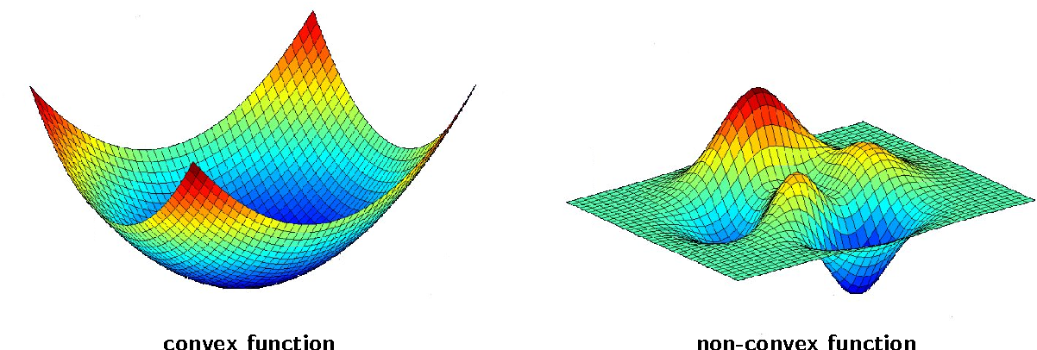

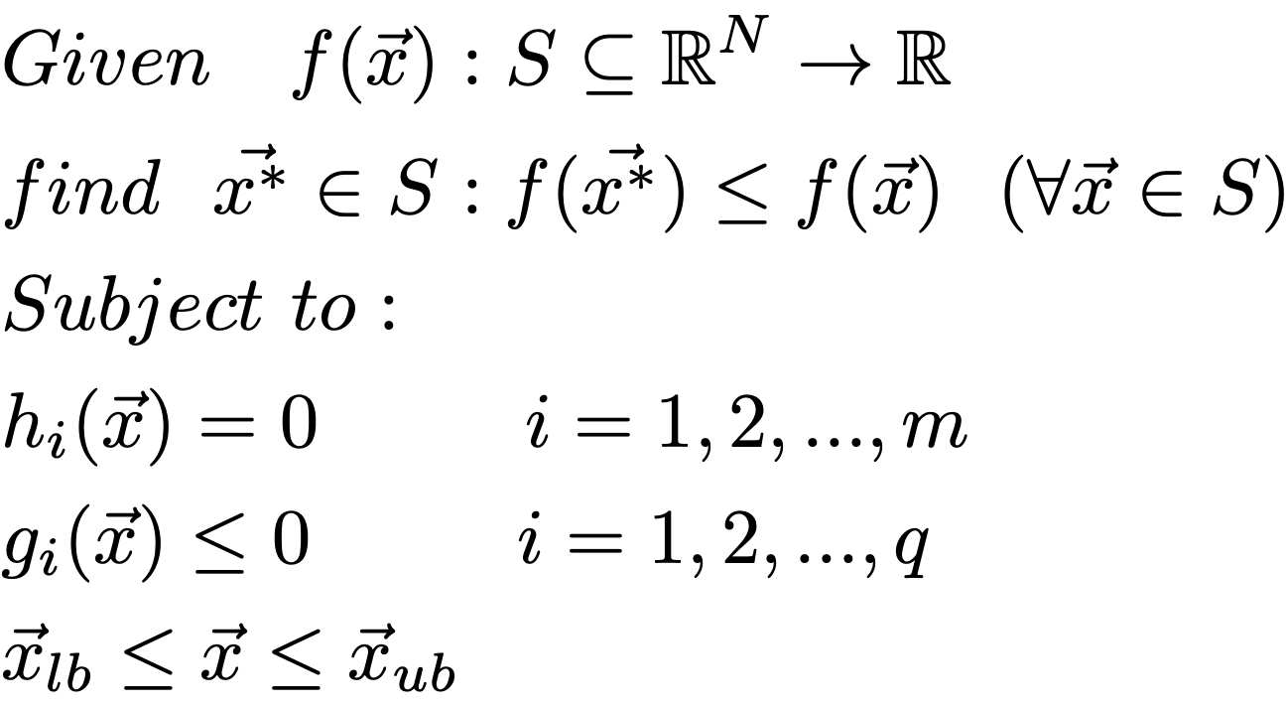
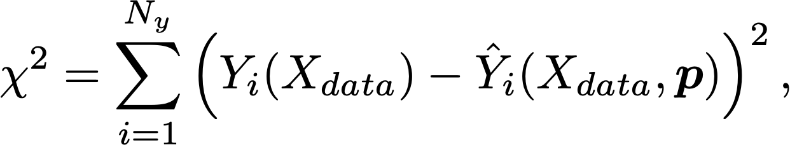
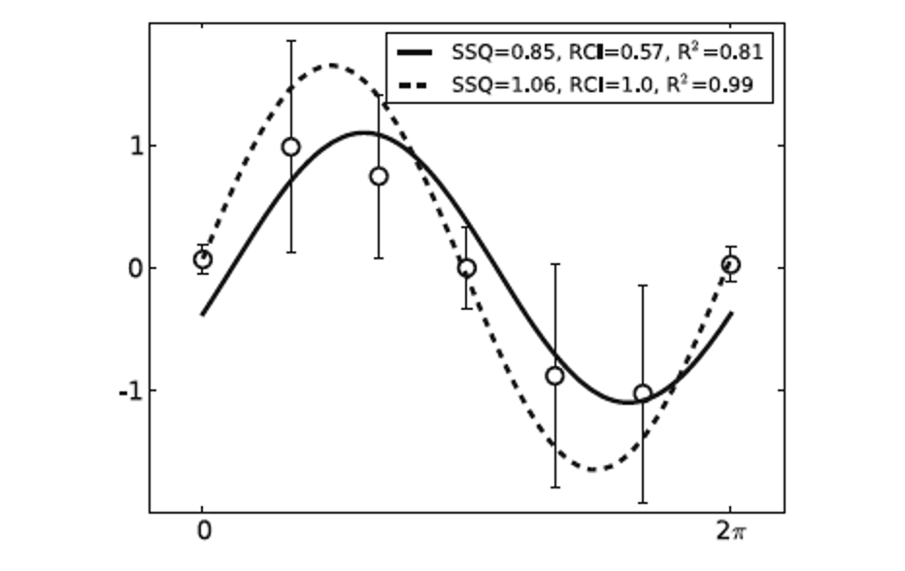
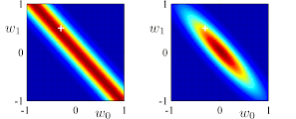
Optimisation problem:
(Score or rank the solutions but with no free lunch)
convex
non convex
Local minima
Objective function
Global minimum
Global minimum
Local search method
(Gradient-based with initial guess)
Gradient Descent, Newton’s Method
Levenberg-Marquardt algorithm, BFGS etc
Global stochastic search method
(gradient-free and random initialisation)
Genetic algorithm, DE, PSO, …
(no free lunch)
The choice of objective function is critical
No natural uncertainty estimation or relation between parameters
(Svensson et al., Neuroinformatics 2012)
Notes:
It has been extremely shown that minimization an object function defined by discrepancy between the measured and simulated data is able to solve parameter estimation problems in many case studies.
There is no a single optimization algorithm which is the best for all or even a broad class of parameter estimation problems and the choice of optimization depends to many criteria such as lin/nonlinearity and dimension of the problem and our a prior knowledge.
Sum of squared error: least-squares cost function. Y: data, Y hat model: output, sigma: measurement errors for N_y data points.
chi-squared error criterion: all variance sigma are equal.
MLE: approximate the posterior as a delta function centered on the MAP estimate, or prior=1.
In recent decades, optimization problem has received increasing (a great deal of) attention, and many optimization algorithms have been proposed and successfully employed in various scientific fields.
In general, the aim of solving an optimization problem is to find the best solution which maximizes or minimizes a real function referred to as fitness or objective function (also known as cost function), while satisfying some constraints.
Solutions of these problems are not account as correct or incorrect, but instead are rated in terms of quality.
The optimal solution must be chosen from a set of candidate solutions known as the search space.
Therefore maximization of function f is equivalent to minimization of -f .
In minimization, we search for a solution which has a fitness function value smaller or equal than all the others.
where f(x) known as as objective function (fitness function or cost function) is the function being optimized, and x denotes a candidate solution.
The domain S is called the search space (or parameter space) which composes all the possible solutions.
The parameter N is the dimensions of the search space, i.e. the number of variables or parameters involved in optimization problem.
A local minimum is a candidate solution which has a smaller value of the objective function than any other candidate solution in a particular region of the search space.
The minimum which has the smallest value of the objective function in the entire search space is called the global minimum.
In general, optimization algorithms can be divided into local and global search algorithms.
It has been extensively reported that for solving the inverse problems in biological systems, evolutionary algorithms
(stochastic global search method) outperform the local search methods.
More sophisticated stochastic methods mimic strategies from biological evolution, other biological or physical phenomena.

Slide 9
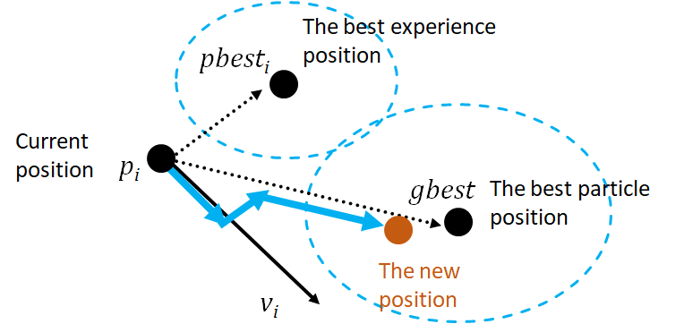


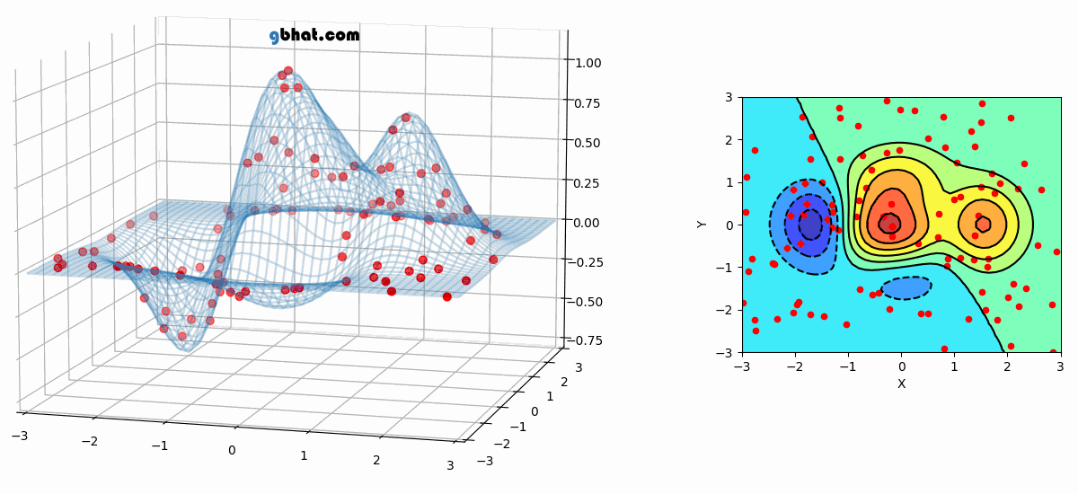
Particle Swarm Optimization (PSO)
School of fish
Flock of birds
Often needs many particles.
There is a trade-off
between g_best local and global
(Exploration-Exploration)

Slide 10
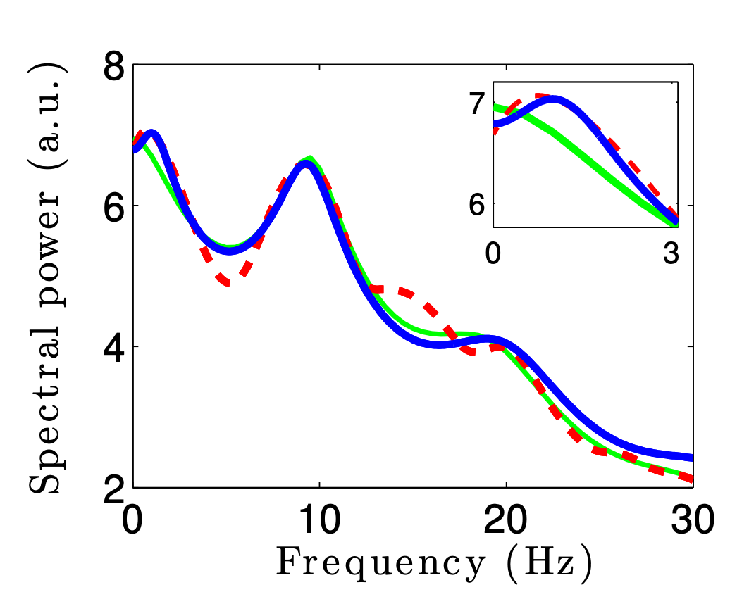
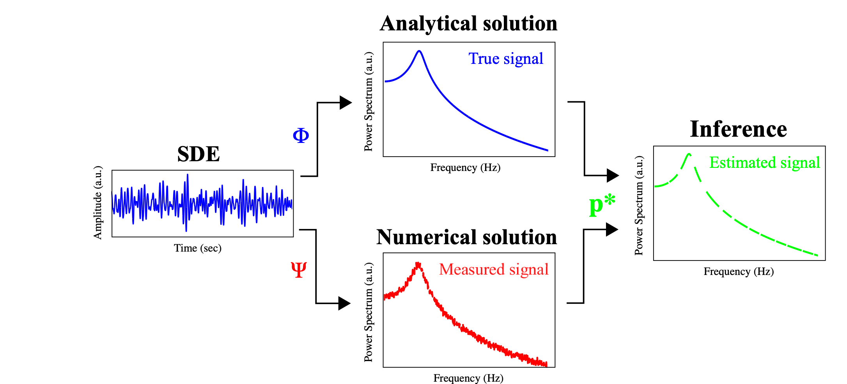
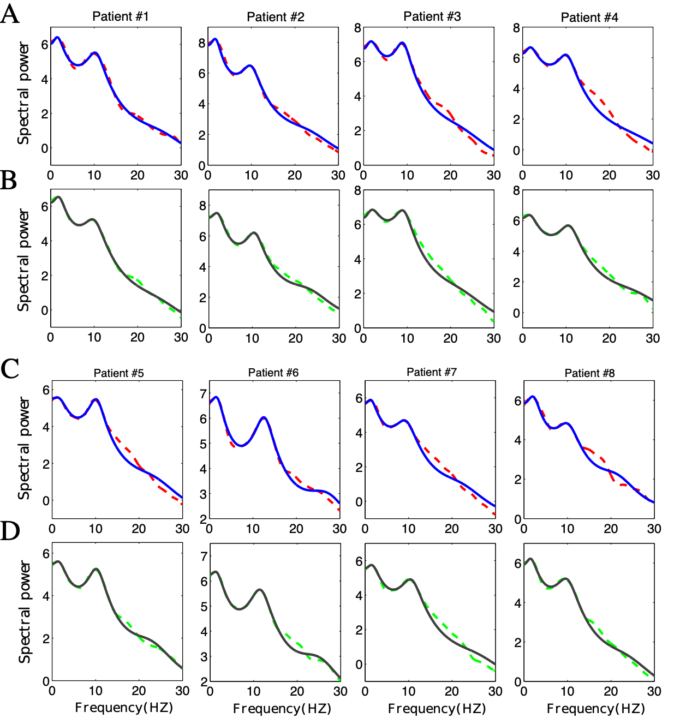
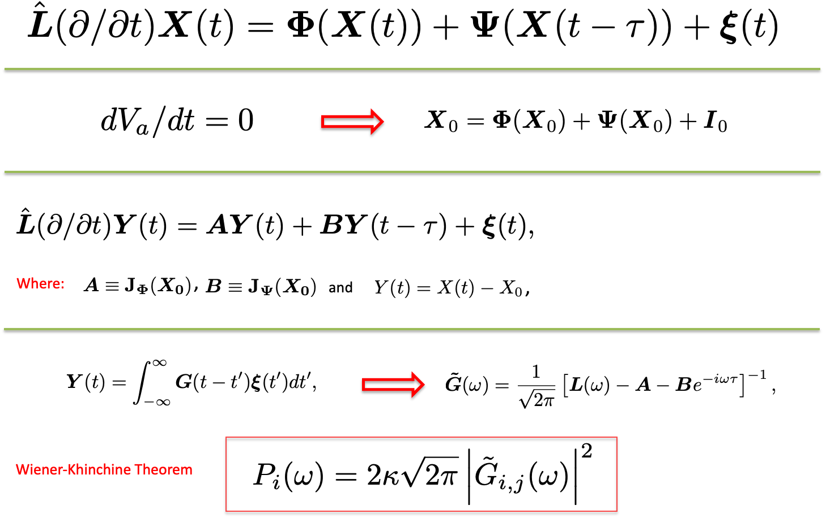
EEG spectral power fitting
Time demain
Frequency demain
Propofol-induced general anaesthesia
Hashemi et al Neuroinformatics 2018
Notes:
We have proposed a novel method to estimate the parameters of ordinary and delay stochastic differential equations: instead of inference from time series,
the unknown parameters are estimated from the power spectrum of signal computed analytically using Green’s function method.
Schematic illustration of parameter inference carried out in this work. In Case studies I and II, to estimated the parameters of a SDE, the true signal (analytical power spectrum)
is fitted to the measured signal (numerical power spectrum). In a similar manner applied to real data measurement, in Case study III, the power spectrum of a neural mass model (true signal)
is fitted to the EEG-spectral power (measured signal).
As can be observed from the schematic illustration, in order to estimate the unknown parameters of a set of SDE, we transform the observation from time-domain to frequency-domain data.
To this end, the power spectrum of the system is computed analytically by the aid of Green function method to generate the true signal, i.e. the signal constructed
by the nominal (true) parameters. In addition, the system spectral power is calculated numerically to acquire the measurement signal. Then, the model parameters
are estimated by fitting the measurement signal to the corresponding true signal.
Under the assumption of spatial homogeneity, the system equations do not depend to spatial locations and obey the general form of functional DDEs, where those terms that have delay are separated from those term without delay.
Vector X is the activity variable here, and bold capital L is a diagonal matrix including all temporal operators L.
By setting all the temporal derivative to zero, the resting state of the system can be obtained. Then by linearizing the system equations around the resting state yields the the following form of linear DDE, where Y is deviation from resting state, and A and B computed from Jacobian matrices at fix point X_0 are constant quadratic matrices.
Substituting a solution in this form of Y in above and applying Fourier transform, we arrive at the Fourier transform of matrix Green’s function G.
Finally applying Wienner-Kninchine Theorem gives the spectral power density (the power spectral density of a stationary process is the Fourier transform of its autocorrelation function )
Where we have assumed that the EEG is generated by the activity of pyramidal cells and by virtue of the specific choice of external input to relay cells, the EEG power spectrum depends to only one component of Greens function.

Slide 11
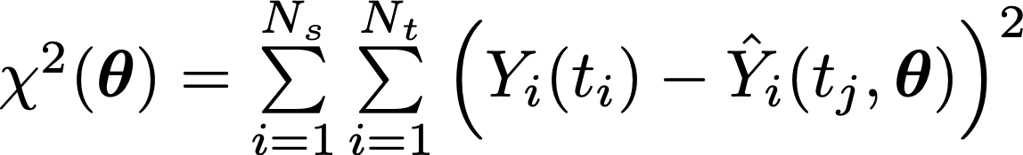
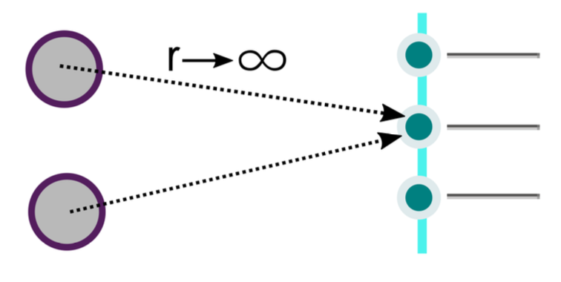
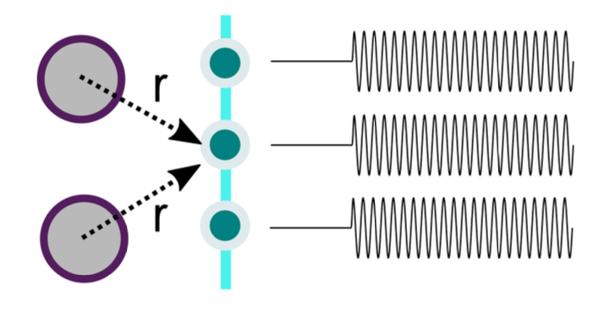
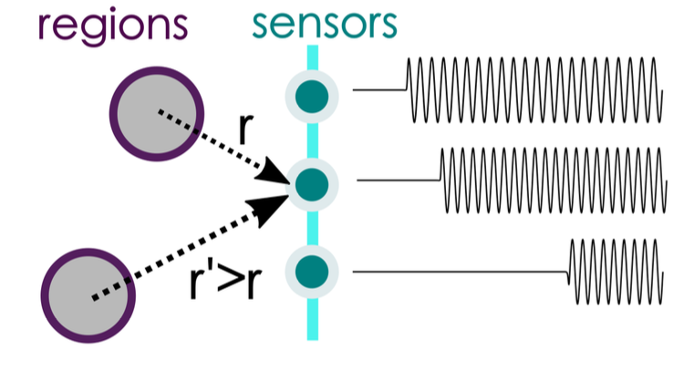

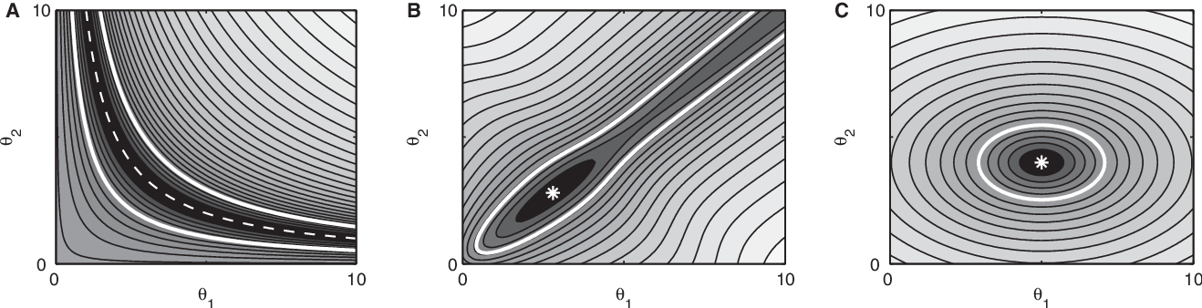
Identifiability (Sensitivity) Analysis
Choose a metric, and sweep on the parameters while fixing other params
Structurally non-identifiability (infinite in both sides): insufficient mapping from model to data and cannot be resolved by increasing the amount or quality of data.
Practically non- identifiability (infinite in one side): arise from a limited amount or quality of recordings under the specific experiment (the sampling rate/noise level)
structural non-identifiability
(c=a+0*b)
practical non-identifiability
(c=a+b)
Identifiable
1D
Raue et al., Bioinformatics 2009
Hashemi et al., Neural Networks 2023
2D

Slide 12

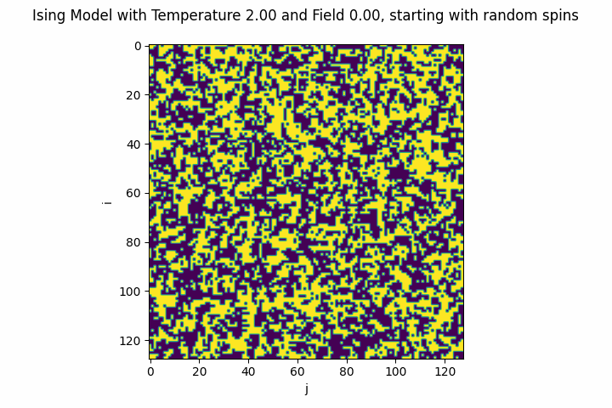
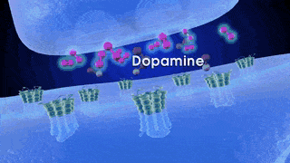
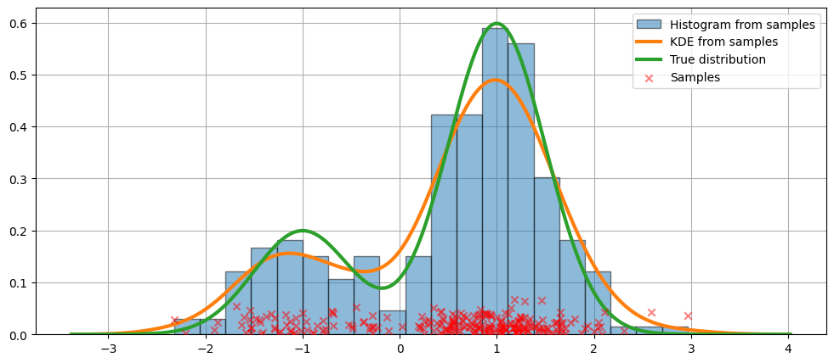
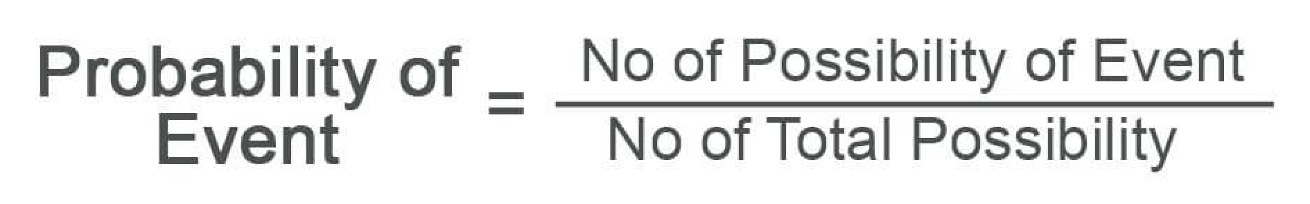
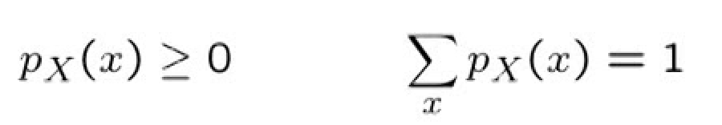
A stochastic system refers to a system or process that inherently incorporates randomness:
Weather Patterns, Thermal fluctuations, Genetic Mutations, Neuronal Firing, Neurotransmitter Release, …
synaptic transmission
A probability distribution is a mathematical function that assigns probabilities (likelihoodness) to different outcomes or events:
So naturally quantify and characterize the randomness and uncertainty.
How probability of measurements are distributed
Finite number of possible outcomes
The time to get a taxi cab={6,3,4,6,2,3,2,6,4,4}; then
P(x=6 min)=3/10, P(x=2 min)=2/10
but what is the probability of P(x=1 min)?
Notes:
p_X
X: randome variable
P(Y=y)
Y: the actual outcome of en event
y: one of possible outomes
P(Y=2)=P(2)=1/6
A probability density distribution is a type of probability distribution used for continuous random variables. It represents the probability of a random variable taking on a specific value within an interval. The integral of the PDF over an interval gives the probability that the random variable falls within that interval. Probability Density Distribution (PDF) specifically refers to the distribution of continuous random variables and uses PDFs to model the probabilities associated with intervals of values.
Stochastic systems inherently involve randomness and uncertainty, and probability distributions are a natural way to quantify and characterize this randomness.
The central limit theorem (CLT) is a fundamental concept in probability theory and statistics. It states that when independent random variables are summed or averaged, regardless of the shape of their individual distributions, the resulting distribution tends to approximate a normal distribution as the number of variables increases
Probability Distribution: A probability distribution is a function that describes how the values of a random variable are distributed. It assigns probabilities to each possible outcome of the random variable.
A probability distribution is a list of outcomes and their associated probabilities (shape). A function that represents a discrete probability distribution is called a probability mass function. A function that represents a continuous probability distribution is called a probability density function
In the absolutely continuous case, probabilities are described by a probability density function, and the probability distribution is by definition the integral of the probability density function.

Slide 13
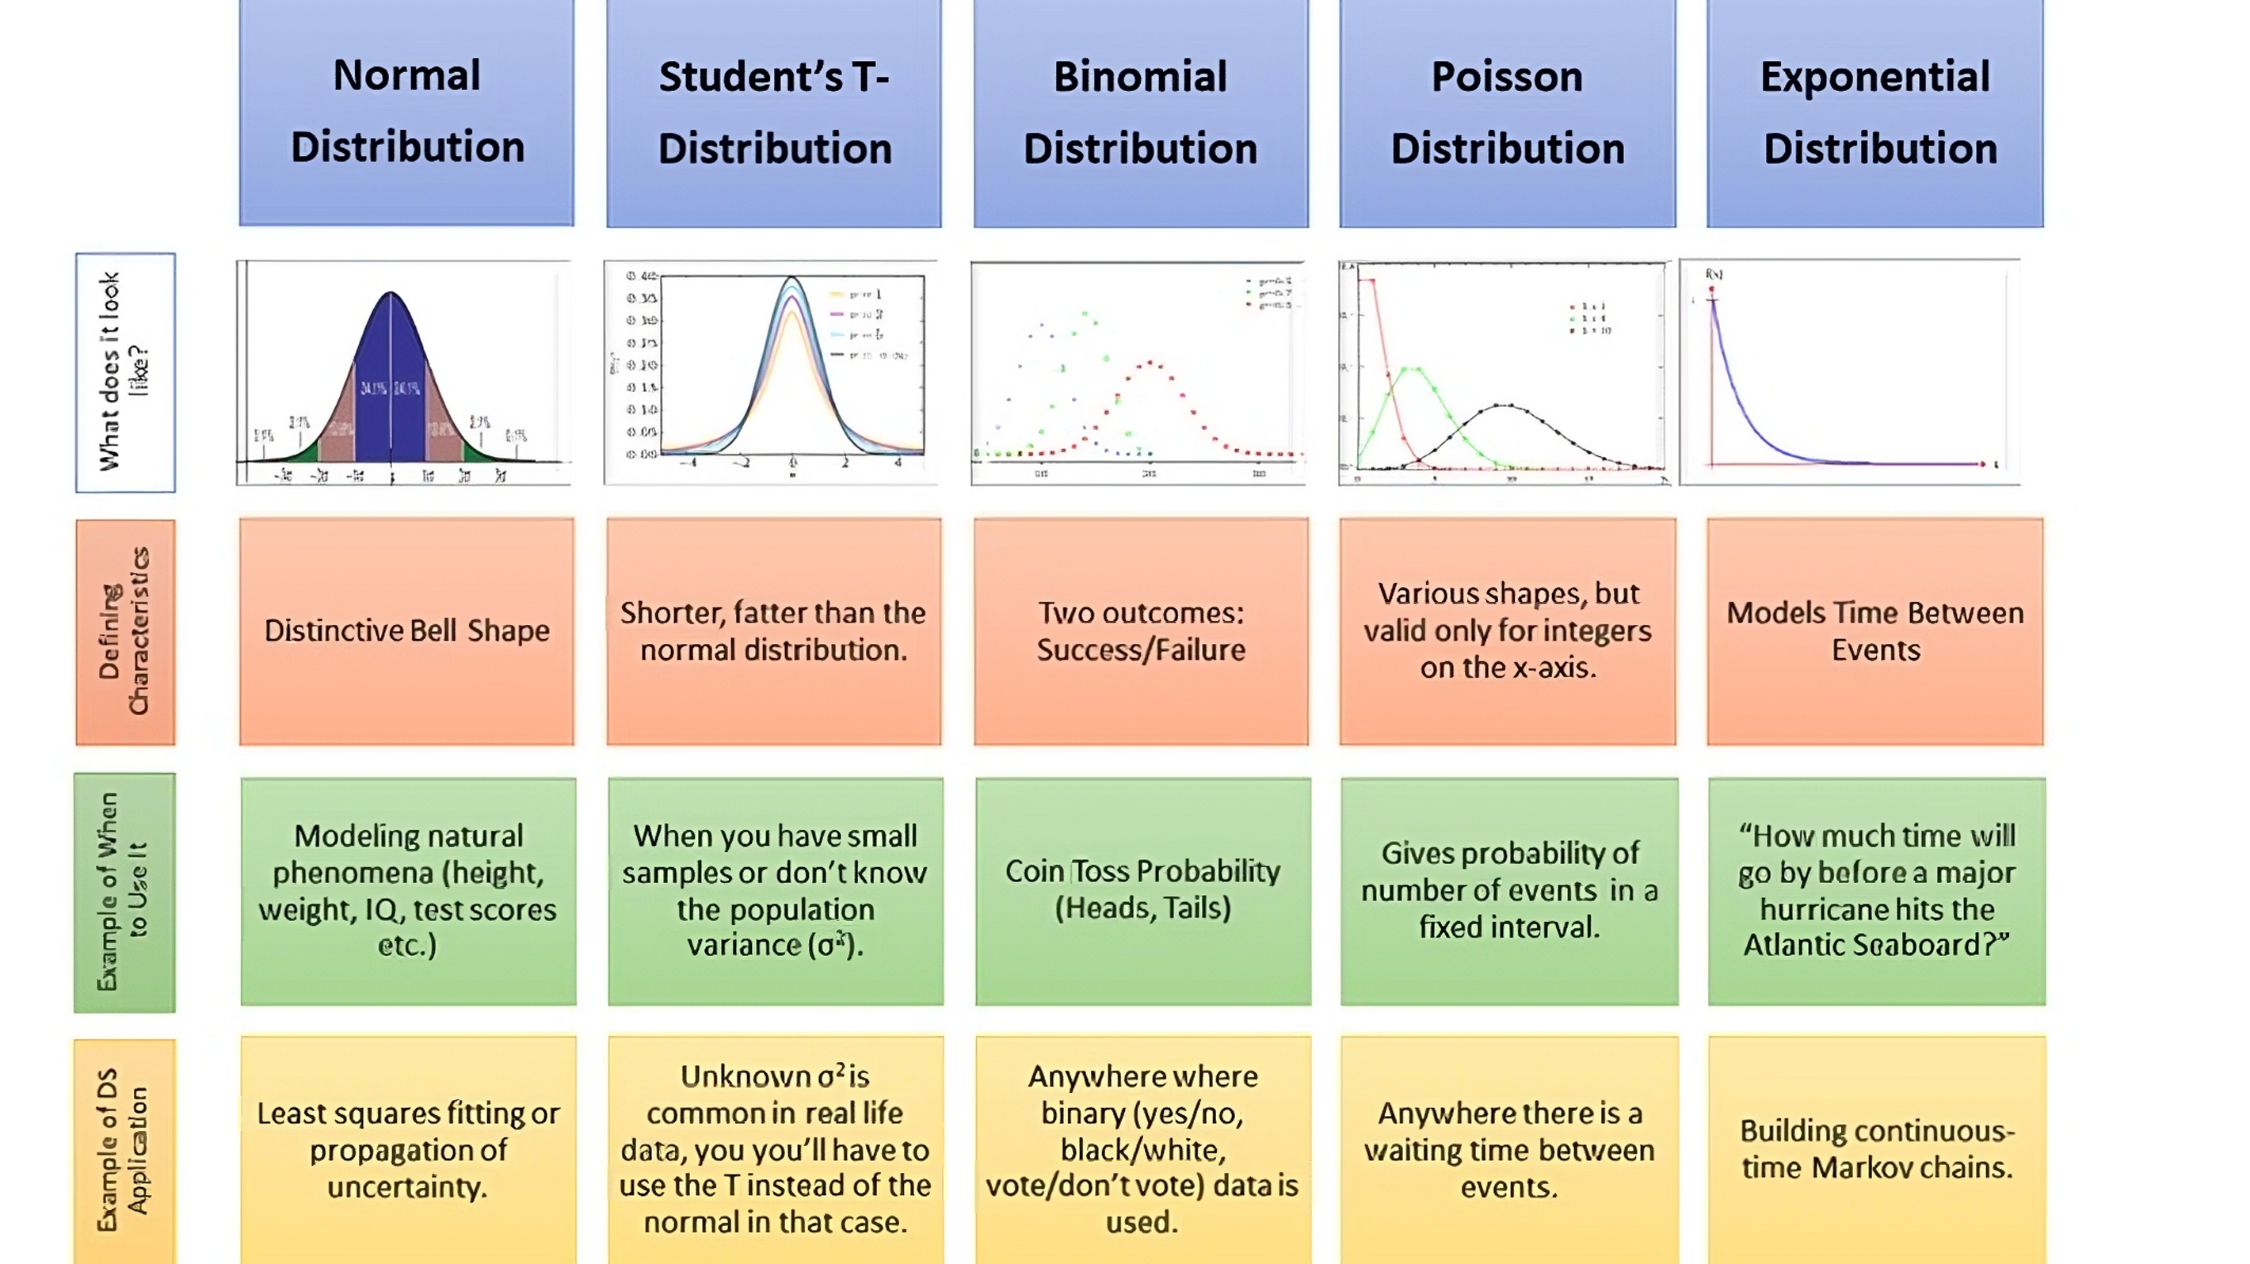
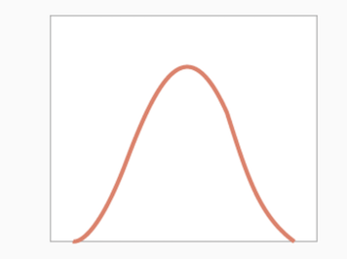
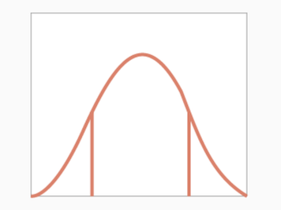
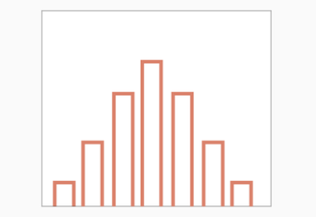
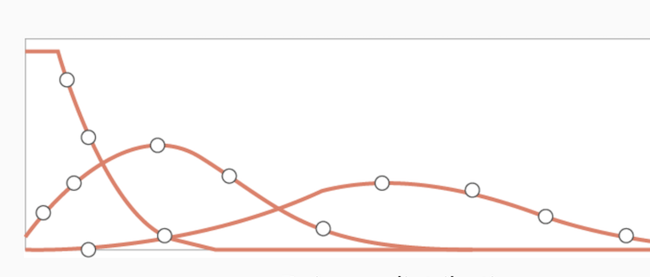
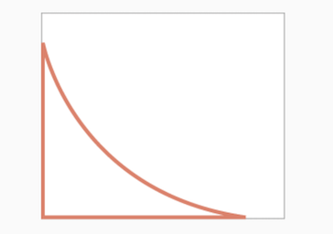
Probability Distributions: is a mathematical function or model that quantifies the possibility of various outcomes
Notes:
A probability distribution is a mathematical function or model that describes the likelihood of various outcomes or values occurring for a random variable. In other words, it provides a way to assign probabilities to different possible events or values of a random process or experiment.

Slide 14
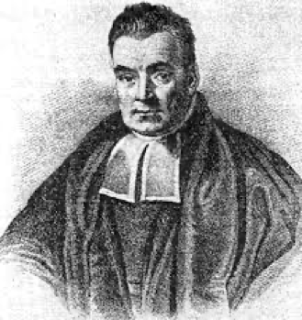
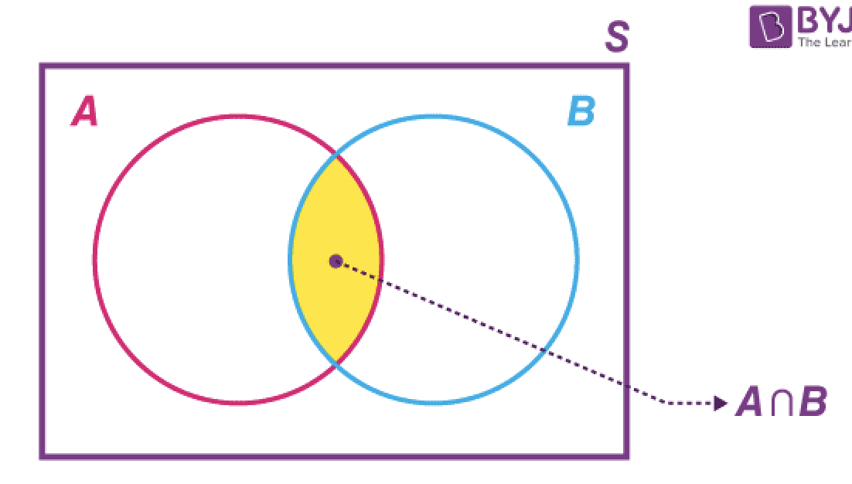
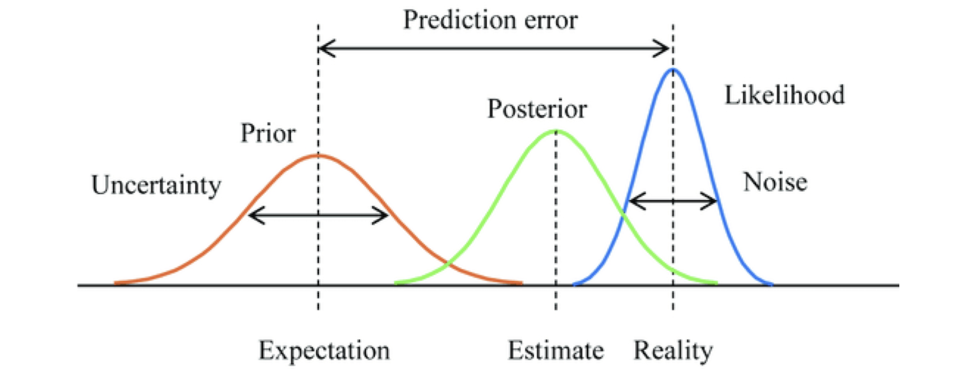

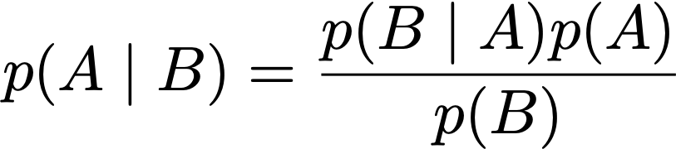
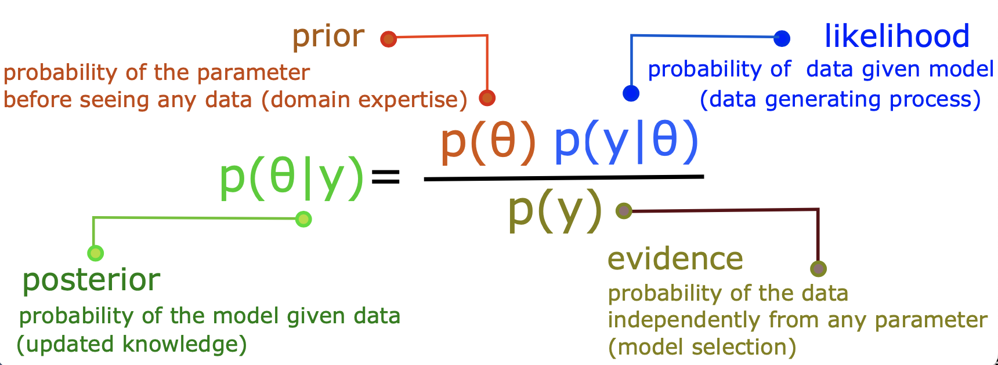
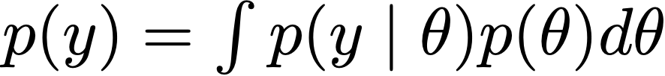
Bayesian inference
Update the prior with likelihood to form the posterior
Product rule
Thomas bayes
(1701-1761)
Integrate patient-specific anatomical data/clinical information, identifiability/degeneracy, model selection, decision-making, …
Challenges : High-dimensional space, correlated variables, non-linearity, geometry and its curvature, hyper parameters, …
How well the model explains the data
Bayesian Data Analysis, Gelman et al 2014
Bishop 2006
Notes:
A rule for updating beliefs based on the fact that the probability of two events occurring together is the probability of the first event, assuming the second has occurred, times the probability of the second event occurring (and vice versa); P(x2, x1)=P(x1|x2) P(x2)=P(x2|x1) P(x1)
Model evidence: How well we can explain the data

Slide 15

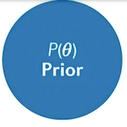

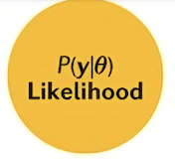
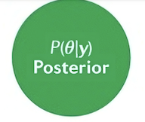
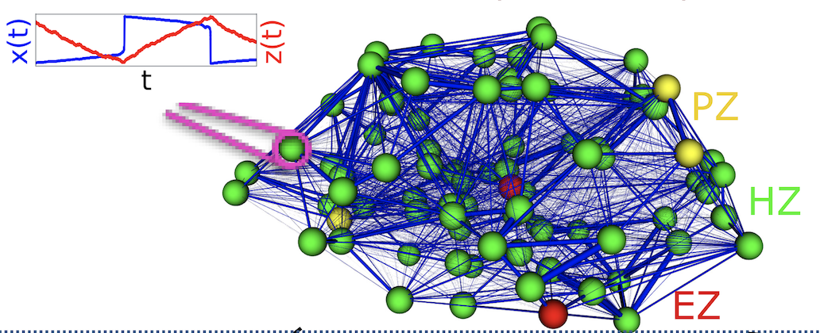
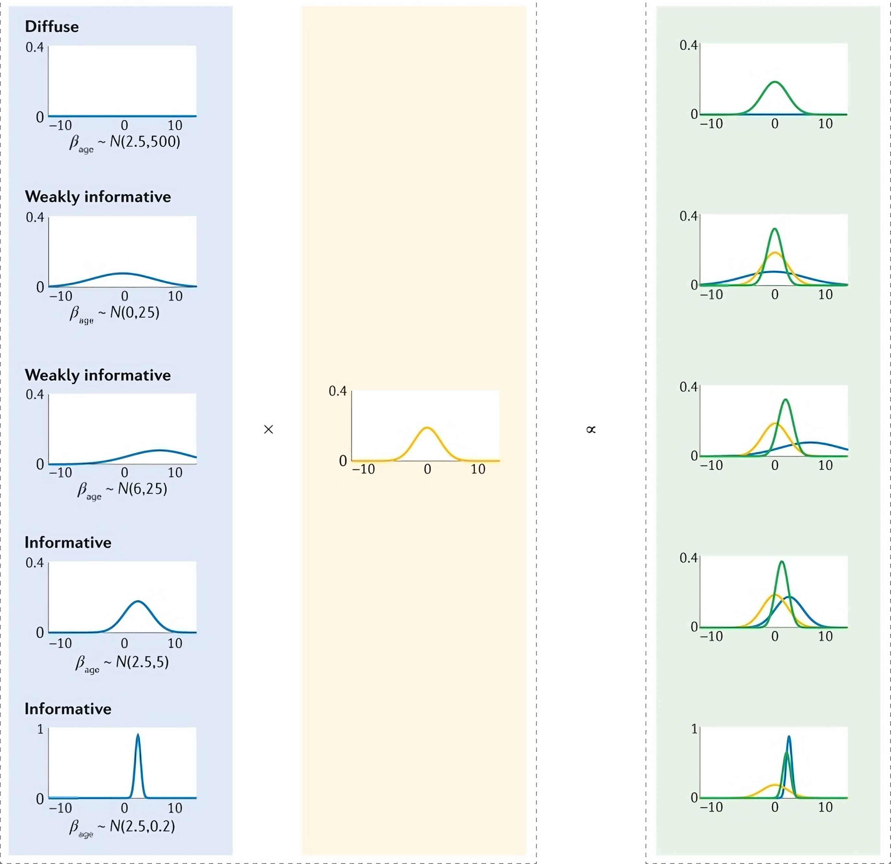

Posterior
is
a
balance
between
prior
and
likelihood
How
data
interacts
with
parameters
Van de Schoot et al, Nature prime 2021
Hashemi et al., PLOS CB 2021
Notes:
How data relates data relates to our parameter

Slide 16

How will be the posterior?
Statistical Rethinking
Book by Richard McElreath

Slide 17




Here we go!
Student prior, Student likelihood (df=2)
The two modes persist - the extra mass in the tails means
each distribution finds the other's mode more plausible
and so the average isn't the best "compromise"
Normal prior, Normal likelihood
The classic flavor of Bayesian updating
the posterior is a compromise between the prior and likelihood
Student prior, Normal likelihood
Now the likelihood dominates
Normal prior, Student likelihood
Now the prior dominates

Slide 18










Frequentist vs Bayesian; the definition of probability and the notion of prior
Frequentist inference
Bayesian inference
Data is repeatable random sample and there is a frequency
Data is fixed, probably a few samples.
Parameters are fixed and unknown and describes by a single value
Parameters are a random and unknown and described by distributions
Probabilities are fundamentally related to the frequencies of events:
In the limit of a large number of repeated measurements, the frequency (a single value) indicates the probability of measuring that value.
Probabilities are fundamentally related the degree of uncertainty (our knowledge):
That probability codifies our knowledge based on prior information and available data;
(distribution of possible values that measure the uncertainty).
No expression of belief (objective view on probability)
Formally present of belief (subjective but consensus-based view on probability)
Point estimates using MLE or least squares estimate, p-value
Posterior distribution with associated stats, Bayes factor
Over an infinite sample size from population
95% of these contain the true population value
A 95% probability that the true
population value is within the posterior
Notes:
there are two different approaches to solve the inverse problem: frequentism and Bayesianism.
In the Bayesian framework the probability is never just a frequency (single value), but a distribution of possible values.
Fundamentally, the disagreement between frequentists and Bayesians concerns the definition of probability.
For frequentists, probability only has meaning in terms of a limiting case of repeated measurements.
That is, if I measure the photon flux F from a given star, then measure it again, then again, and so on, each time I will get a slightly different answer due to the statistical error of my measuring device. In the limit of a large number of measurements, the frequency of any given value indicates the probability of measuring that value. For frequentists probabilities are fundamentally related to frequencies of events. This means, for example, that in a strict frequentist view, it is meaningless to talk about the probability of the true flux of the star: the true flux is (by definition) a single fixed value, and to talk about a frequency distribution for a fixed value is nonsense.
For Bayesians, the concept of probability is extended to cover degrees of certainty about statements. Say a Bayesian claims to measure the flux F of a star with some probability P(F): that probability can certainly be estimated from frequencies in the limit of a large number of repeated experiments, but this is not fundamental. The probability is a statement of my knowledge of what the measurement result will be. For Bayesians, probabilities are fundamentally related to our own knowledge about an event. This means, for example, that in a Bayesian view, we can meaningfully talk about the probability that the true flux of a star lies in a given range. That probability codifies our knowledge of the value based on prior information and/or available data.
We'll make the reasonable assumption that errors are Gaussian. In a Frequentist perspective, error is the standard deviation of the result of a single measurement event in the limit of repetitions of *that event*. In the Bayesian perspective, error is the standard deviation of the (Gaussian) probability distribution describing our knowledge of that particular measurement given its observed value)
Frequentist probability defines an event's probability as the limit of its relative frequency in a large number of trials.

Slide 19







Maximum likelihood estimation (MLE) & Last square error (LSE)
If we assume no prior, and independent & normally distributed errors:
Maximum Likelihood Estimate (MLE): maximizing the likelihood function (the log-likelihood):
Least Squares Estimation (LSE): minimizing the sum of squared error:
MLE
Notes:
The likelihood function is the probability of obtaining the set of observed data, with a given set of parameter values. The set of parameters which maximizes the likelihood function is called the maximum likelihood estimator (MLE).
If the error residuals are assumed to be uncorrelated and normally distributed (the measurement errors are uncorrelated with Gaussian distribution) the MLE assesses the quality of estimated parameters by maximizing the likelihood function (or equivalently the log-likelihood function which is easier to work mathematically).
Since the error terms are assumed to be independent, the combined likelihood of all the measurements can be written as a product.
maximizing the likelihood is equivalent to maximizing the log-likelihood function.
LSE involves a minimisation over of a suitable objective function that measures the distance (or discrepancy) between model.
if we assume additive uncorrelated Gaussian noise on the measurements, maximizing the log likelihood is equivalent to minimizing the sum of squared residuals between the model simulations and the experimental data.

Slide 20


Latent space: (embedding space) is an abstract multi-dimensional space where represents the essential features or patterns of the
original data (lower/higher dims).
Lower dimension (Autoencoders for big data)
Higher dimension (Nonlinear State space modeling)
Generative models (generate data)
NOT directly empirically measurable
Plato’s Allegory of Caves
In the allegory of "The Cave", Plato describes a group of people who have lived chained to the wall of a cave all their lives, facing a blank wall.
The people watch shadows projected on the wall from objects passing in front of a fire behind them and give names to these shadows.
The shadows are the prisoners' (fragment of) reality,
but are not accurate representations of the real world?!
To understand and perceive the higher levels of reality
Notes:
encodes a meaningful internal representation of externally observed events
Allegory ( symbolic representation): As a literary device or artistic form, an allegory is a narrative or visual representation in which a character, place, or event can be interpreted to represent a hidden meaning with moral or political significance.
The Allegory of the Cave, or Plato's Cave, is an allegory presented by the Greek philosopher Plato in his work Republic (514a–520a) to compare "the effect of education (παιδεία) and the lack of it on our nature".

Slide 21





State space modeling
Dynamical Causal Modeling
(DCM)
observed y
f: neural mass models
h: lead field matrix
HZ
PZ (low-coupling)
x
y
PZ (strong-coupling)
EZ

Slide 22
How to make inference?

Slide 23







Probabilistic Programming Language (PPLs)
Fast in user time, reliable, and automatic
Automatic inference algorithms and Automatic differentiation
Full Bayesian statistical inference with MCMC sampling (NUTS, HMC)
Approximate Bayesian inference with variational inference (ADVI)
Penalized maximum likelihood estimation with optimization (L-BFGS)
Notes:
We have large data set and complex models, thus we need complex inference to achieve rich inference. This leads to probabilistic programming (automated inference).
Stan is a flexible probabilistic programming system. Stan describes a high-level language to define probabilistic models as well as a model compiler, a library of transformations, and an
efficient automatic differentiation toolbox.
In Stan, the scientist only provides a probabilistic model and a dataset, nothing else.
PyMC3 is a Python package for Bayesian statistical modeling and Probabilistic Machine Learning which focuses on advanced Markov chain Monte Carlo and variational fitting algorithms.
Theano is a Python library that allows you to define, optimize, and evaluate mathematical expressions involving multi-dimensional arrays efficiently, especially ones with multi-dimensional arrays.
Using Theano it is possible to attain speeds rivaling hand-crafted C implementations for problems involving large amounts of data.
Theano is a library that allows expressions to be defined using generalized vector data structures called tensors.

Slide 24







Monte Carlo simulations; a large number of repeated random simulations to obtain the statistical properties.
In the 1930s, Enrico Fermi first experimented with the MC method while studying neutron diffusion.
In the late 1940s, Stanislaw Ulam invented the modern version of MCMC while he was working on nuclear weapons projects at the Los Alamos National Laboratory.
In 1948, Neumann, Metropolis and others programmed the ENIAC computer to perform MC, of a fission weapon core.
In the 1950s MC methods were used at Los Alamos for the development of the hydrogen bomb.
In the late 1990s, applications in physics, genetic, biology etc.
The common between a MC situations and the MC casino is
running dice
MC casino, where Ulam’s uncle used to gamble
From 1950 to 1996, all the publications on Sequential Monte Carlo methodologies
Notes:
Image fro left to right :
Nicholas Constantine Metropolis (1915-1999)
Stanisław Ulam (1909-1984)
Arianna W. Rosenbluth (first implementation of MCMC in code) 192-2020
In the 1930s, Enrico Fermi first experimented with the Monte Carlo method while studying neutron diffusion, but he did not publish this work.
In the late 1940s, Stanislaw Ulam invented the modern version of the Markov Chain Monte Carlo method while he was working on nuclear weapons projects at the Los Alamos National Laboratory.
Von Neumann, Nicholas Metropolis and others programmed the ENIAC computer to perform the first fully automated Monte Carlo calculations, of a fission weapon core, in the spring of 1948.
In the 1950s Monte Carlo methods were used at Los Alamos for the development of the hydrogen bomb,
It was in 1993, that Gordon et al., published in their seminal work[36] the first application of a Monte Carlo resampling algorithm in Bayesian statistical inference (the bootstrap filter; does not require any assumption about that state-space or the noise of the system ).
Being secret, the work of von Neumann and Ulam required a code name. A colleague of von Neumann and Ulam, Nicholas Metropolis, suggested using the name Monte Carlo, which refers to the Monte Carlo Casino in Monaco where Ulam's uncle would borrow money from relatives to gamble
Monte-Carlo trolley, or FERMIAC: was an analog computer invented by physicist Enrico Fermi to aid in his studies of neutron transport

Slide 25

Monte Carlo simulations; to estimate possible outcomes of an uncertain event by randomness rather simulating all combinations
The application of Monte Carlo simulations for numerical integration, averaging, optimisation and inverse problem, and generating samples from a
probability distribution to estimate the uncertaining of events for design making, ranging from materials science, economy, biology to quantum physics.
Notes:
Advantages: generate multiple possible outcomes and calculate the average result.
Integrate subject specific information and prior predictive check
Estimation of posterior (reliability for causal inference/prediction)
Statistical relation between parameters (identifiability/degeneracy)
model selection, comparison and hypothesis evaluation from evidence
Challenges:
High-dimensional parameter spaces involving correlated variables
Geometry of the target distribution and its curvature
Computationally expensive (likelihood evaluation)
Sensitivity and Convergence (sample mixing)
Task-dependent algorithm
Hyperparameter tuning

Slide 26







Monte Carlo Principle; Integration=Expectation; any expectation can be calculated with random sample
Consider a quadrant (circular sector) inscribed in a unit square. Given that the ratio of their areas is π/4
Uniformly scatter a given number of points over the square
# no. of points inside quarter of circle
=
π/4 <1
Count the number of points inside the quadrant, i.e. having a distance from the origin of less than 1
# no. of points inside square
The integration = The expectation of function f(x), with respect to a distribution P(x):
Notes:
LLN: According to the law, the average of the results obtained from a large number of trials should be close to the expected value and tends to become closer to the expected value as more trials are performed.
Law of Large numbers says that sample average converges towards the expectation.
import random
# Function to estimate the value of pi using Monte Carlo methods
def estimate_pi(num_samples):
num_inside = 0
for i in range(num_samples):
x = random.uniform(-1, 1)
y = random.uniform(-1, 1)
if x**2 + y**2 <= 1:
num_inside += 1
pi_estimate = 4 * num_inside / num_samples
return pi_estimate
# Estimate the value of pi using 10,000 samples
pi_estimate = estimate_pi(10000)
print("Estimated value of pi:", pi_estimate)

Slide 27






Markov chain Monte Carlo (MCMC); exact but slow
A class of computational algorithms to construct an ergodic Markov chain, whose stationary distribution asymptotically approaches to the target (posterior) distribution.
Markov property refers to the memoryless property of a stochastic process;
The future is independent of the past given the present.”
Metropolis–Hastings algorithm:
Generate proposal x’
Draw random r from uniform distribution [0,1];
If ; accept and update to xt+1 =x’
Otherwise: reject and xt+1 =xt
Target:
Proposal:
Arbitrary! (eg., Gaussian)
Notes:
Ergodicity is where the ensemble average equals the time average
One of the most 10 influential algorithms in 20th cent
We draw samples from a (simple) proposal distribution so that each draw depends only on the state of the previous draw (Markov property). Under certain conditions, the Markov chain will have a unique stationary distribution, which converge to proposal distribution.
he term Markov chain refers to a sequence of stochastic states such that the transition probabilities from one state to another depends only on the previous state of the chain:
At each iteration, a sample candidate is drawn from an arbitrary proposal distribution,
which determines the next sample value based on the current sample value. In other word, a
trial transition to a candidate state is proposed randomly from the present state. Then,
the candidate sample is either accepted or rejected with some probability a .
the most commonly used MCMC method for obtaining a sequence of random samples from a probability distribution is Metropolis-Hastings (MH) algorithm.
An attractive property of the Metropolis algorithm is that the target distribution does not have to be a properly normalized probability distribution. This is due to the fact that the acceptance probability is based on the ratio of two values of the target distribution.
Existence of stationary distribution: there must exist a stationary distribution π ( x ) \pi (x). A sufficient but not necessary condition is detailed balance, which requires that each transition x → x ′ {\displaystyle x\to x'} is reversible: for every pair of states x , x ′ {\displaystyle x,x'}, the probability of being in state x x and transitioning to state x ′ x' must be equal to the probability of being in state x ′ x' and transitioning to state x x, π ( x ) P ( x ′ ∣ x ) = π ( x ′ ) P ( x ∣ x ′ ) {\displaystyle \pi (x)P(x'\mid x)=\pi (x')P(x\mid x')}.
Uniqueness of stationary distribution: the stationary distribution π ( x ) \pi (x) must be unique. This is guaranteed by ergodicity of the Markov process, which requires that every state must (1) be aperiodic—the system does not return to the same state at fixed intervals; and (2) be positive recurrent—the expected number of steps for returning to the same state is finite.

Slide 28





Hamiltonian Monte Carlo (HMC)
Gradient-free: fast but designed for low-dimensional problems
Gradient-based: expensive but designed for high-dimensional problems
HMC uses an auxiliary variable (momentum)
to avoid random walk (lower rejection rate)
(simulating Hamiltonian dynamics)
HMC is sensitive to stepsize and integration interval;
Large step size: Divergence
Small step size: waste of computational time
H(p, q)=T(q)+V(q)
Notes:
HMC is able to suppress such random walk behavior by means of a clever auxiliary
variable scheme that transforms the problem of sampling from a target distribution into the problem of simulating Hamiltonian dynamics.
Hamiltonian dynamics describe an object’s motion in terms of its location and momentum (equivalent to the object’s mass times its velocity) at some time. Hamiltonian dynamics describe how kinetic energy is converted to potential energy (and vice versa) as an object moves throughout a system in time. This description is implemented quantitatively via a set of differential equations known as the Hamiltonian equations:

Slide 29






No-U-Turn Sampler (NUTS): self-tuning variant of HMC
Re-parameterization
NUTS: The no-u-turn sampler: Adaptively setting path lengths in HMC (Hoffman, M.D., Gelman, A., JMLR 2014)

Slide 30



Variational Inference (VI); not exact but fast
VI turns inference into an optimisation process,
Posit a variational family of distributions,
Finds the closest (in KL) to the target,
The mean-field factorization ignores the inter-dependency between variables,
Laplace approximations (i.e., unimodal normal densities) ignores multimodality.
Notes:
In mean-field approximation, it assumes that the posterior distribution can be factorized into independent distributions over the model's variables. It is a simplifying assumption where each variable is treated as independent of the others.
Laplace approach approximates the posterior distribution using a Gaussian distribution, often centered at the mode of the true posterior

Slide 31






Kullback–Leibler (KL) divergence: measure of the difference between two probability distributions.(relative entropy; expected surprise)
a measure of how one probability distribution P is different from reference Q.
KL is asymmetric divergence
(not a distance metric)
Forward KL; mass-seeking
Reverse KL; mode-seeking
Notes:
KL is divergence not a distance metric (positive define and symetric)
KL: how much information we lose when we choose an approximation
KL is the expectation of the logarithmic difference between the probabilities P and Q ;
how many bits of information we expect to lose
Joint entropy - reference entropy

Slide 32







Variational free energy or Evidence lower bound (ELBO)
Minimizing KL=Maximizing ELBO=Maximizing Variational Free energy
We construct a quantity that lower bounds (the log of) the evidence,
often referred to as an evidence lower bound (ELBO) or a variational free energy:
(Error ≥0 )
Variational free energy is a lower bound on the model evidence (log marginal likelihood of model).
(ELBO )
or
(Variational free energy)
(Evidence)
q
The log evidence is defined as:
q
Free energy= Evidence - Error
Model evidence=KL divergence + Variational Free energy
(Training ML/AI)
Free energy= Accuracy - Complexity
(select the model with the most positive free energy)
This is log of an average, so by Jansen’s inequality,
a lower bound of this will be the average of the log,
which is called Free energy
Free energy= expected (negative) Energy + Entropy
E[.]: expected value or average
Jaynes’ Principle of Maximum Entropy (1957):
Thermodynamic (Clausius) entropy=Information (Shannon) entropy
From two candidate, we select the one with the higher entropy
(the simplest explanation for the data)
The probability distribution which has maximum entropy (uncertainty)
is the only unbiased choice to be made
the log of an average is always
larger than or equal to the average of a log
The next step will be to maximize this lower bound, i.e.,
find the probability density Q(θ) that maximizes
the free energy, so F ≈ ln P(y).
Zeidman et al., NeuroImage 2023
Notes:
Model Evidence: How well the data is explained by the model
Or The level of information gained by belief updating
Evidence: Empirical data or observable information that can be used to support or reject a hypothesis.
ELBO depends only on proposals q, and log p is fixed (does not depend on q).
The principle of maximum entropy suggests that, among the beliefs that are compatible with the observation, we should choose the most “unbiased” belief, in the sense that it corresponds to a maximum number of possible assignments of the hidden variables.
Free energy= Expected (negative) energy + Shannon Entropy
Ln P(y)=Ln int P(y, \theta) d\theta
That means that if we can express ln P(y) as the average of a log, then to construct a lower bound we simply need to rearrange terms to get the log of an average
Any point on the secant line, such as y_A, is a weighted average of f(x_1) and f(x_2):
y_A=af(x_1)+(1-a)f(x_2).
Jensen's inequality says that this average-of-functions will always be less than or equal to the corresponding function-of-the-average:
y_B=f(ax_1+(1-a)x_2), Thus, using the notation of expected values,
E(f(x)) < f(E(X))
a system tends to its state with maximum entropy at the largest rate. According to the Second Law of Thermodynamics a spontaneous change results in an increase in the entropy of the universe. In an isolated system, when the system's entropy reaches the maximum, the system stays there because any further change would reduce entropy. That's obviously the equilibrium position

Slide 33










Entropy: measure of disorders (randomness); the amount uncertainty represented by probabilities
Dispersion of a drop of ink in water
High entropy
on average high surprised
Low entropy
on average less surprised
High Entropy
High Disorder, High Randomness
(More probable)
Low Entropy
Low Disorder, Low Randomness
(Surprise: deviation fro expected value)
An improbable outcome is therefore surprising
Probability of picking blue is high,
so the surprise is low
Surprise is inversely related to the probability
Entropy= average of surprise
Notes:
More similarities, more entropy, as we increase the difference, we lower the entropy.
Under ergodic assumptions, the long-term average of surprise is entropy
A probability density Q(θ) with high entropy will
be smooth (or in the limit, flat) over the possible values of θ, whereas a
probability density with low entropy will have peaks around particular
values. This means that if we have two candidate Q(θ) densities, both
equally likely under the priors, to maximize the free energy we would
select the one that is smoother or, equivalently, with the higher entropy.
This is referred to as Jaynes’ Principle of Maximum Entropy (Jaynes,
1957), and means that we select the simplest explanation for the data
where possible.
According to the maximum entropy principle, the best guess is the one which maximises the information entropy under the given constraints.
The principle of maximum entropy states that the probability distribution which best represents the current state of knowledge about a system is the one with largest entropy,
The second law of thermodynamics states that the total entropy of a system either increases or remains constant in any spontaneous process; it never decrease
The Principle of Maximum Entropy is based on the premise that when estimating the probability
distribution, you should select that distribution which leaves you the largest remaining uncertainty (i.e., the maximum entropy) consistent with your constraints.
The larger std, the larger entropy. In this context, we maximize entropy to represent a more unbiased or less informative probability distribution.
the probability distribution which has maximum entropy is the only unbiased choice to be mad

Slide 34






Free-energy principle
DCM & Active Inference
How could the data have been caused?
Divergence
Variational free energy
Free Energy= Negative variations free energy= Negative model evidence
Observed data
(EEG/MEG/fMRI, etc)
F: maximum amount (upper bounds) of Surprise
Surprise (self-information): negative log probability of observed outcome
S=−ln P(Y=y); so free energy is upper bound on surprisal
Karl Friston
KL ≥ 0, so: Free Energy ≥ −ln p(y)
The brain reduces surprise or uncertainty.
An organism acts to minimize free energy or
maximize model evidence to resists to natural disorders.
Generative Model
Bottom-up: estimating the effects, knowing the causes
Top-down: estimating the causes, knowing the effects
Forward model
Inverse problem
F: the difference between internal model of the world (beliefs and expectations) and sensory input from the external environment.
The brain updates its internal model through perception and generates actions to minimize the sensory uncertainty (free energy).
Hidden states
(Characterised by parameters)
Notes:
Friston Free energy =-logP=-ELBO=-Variational Free energy
Under ergodic assumptions, the long-term average of surprise is entropy.
Slef-organized systems resist the natural tendency to disorders.
F: an information theory measure that upper bounds (is grater than) the surprise on sampling some data (sensory inputs), given a generative model.
The free energy principle is a theoretical framework suggesting that the brain reduces surprise or uncertainty by making predictions based on internal models and updating them using sensory input.
free energy is the maximum amount of surprise an organism can experience upon arriving at some new evidence or sensory data, or more specifically, it is the upper bound on that surprise!
The free energy principle is a theoretical framework suggesting that the brain reduces surprise or uncertainty by making predictions based on internal models and updating them using sensory input
https://www.kaggle.com/code/charel/learn-by-example-active-inference-in-the-brain-1
free energy, in thermodynamics, energy like property or state function of a system in thermodynamic equilibrium.
Active inference is a theory that characterizes perception, planning, and action in terms of probabilistic inference.
biological agents resist a tendency to disorder and therefore minimize the entropy of their sensory states
Enropy=Average Surprise
Enropy=𝔼{Surprise}
Enropy=𝔼{−lnP(S)}
Surprise rests on predictions about sensations
F ≥ −lnP(S)
‘free energy’ is an upper bound on surprisal,
surprise is the negative natural logarithm of the probability of the observed outcome:
S=−ln P(X=x)
Free energy is the surprisal an organism experiences upon sampling some data, given a generative model.
Free energy is an upper bound on surprisal! F> -ln P(y)
Free energy is the surprisal an organism experiences upon sampling some data, given a generative model
free energy represents the difference between the brain's predictions and sensory inputs.
Note that the free energy is sometimes defined to be the negative of this quantity.
In Friston's framework, the concept of "free energy" is related to the brain's role in minimizing surprise or uncertainty about its sensory inputs and maintaining a stable internal model of the world.
In Friston's theory, the brain is seen as a system that tries to minimize its "free energy," which represents a combination of prediction error and uncertainty in its internal model. This minimization process, according to the Free Energy Principle, leads to adaptive behavior and the brain's ability to generate predictions and take actions to reduce surprise or maintain internal stability.
Surprise or self-information is the negative log probability of an outcome.
The Helmholtz free energy, A, is defined as:
F = U - TS
Helmholtz free energy is a measure of the energy available to do useful work in a system, considering that some of the internal energy (U) may be unavailable due to the system's entropy (S) at a given temperature (T).
The total free energy during a spontaneous change can only decrease. So we minimise entropy as a way to reduce uncertainty or make a system more predictable.
Gibbs free energy, also known as Gibbs energy, or free energy, is a quantity used to quantify the overall amount of work performed in a system when temperature and pressure remain constant.
The change in Gibbs free energy (ΔG) equals zero when a system is at equilibrium. At equilibrium, the system has reached a state of balance where the forward and reverse reactions occur at the same rate, and there is no net change in the concentrations of reactants and products over time.
Gibb's free energy is negative when the reaction is spontaneous at a particular temperature, and positive when the reaction is non-spontaneous.
Active inference: internal states appear to infer the hidden causes of their sensory states (by increasing model evidence) and actively influence those causes
https://mundyreimer.github.io/blog/free-energy-principle

Slide 35





Approximate Bayesian Computation (ABC)
prior
proposal
simulator
compare
data
posterior
exact only if
Curse of dimensionality
Sensitivity to thresholding

Slide 36




Simulation-based Inference (SBI) or Likelihood-free inference (LIF)
Parameter
space
Data
space
The calculation of likelihood is expensive (high dimensional latent space),
We have access to the data features rather than time series (firing rate instead of spike timing),
Model are not differentiable (HH).
f
simulator (@parameters):
—simulate model with input parameters
return (data features)
Invertible
?
B
NFs
Rezende, et al., PMLR 2015
Papamakarios et al., PMLR 2019
Cranmer et al., PNAS 2020
Gonçalves et al., elife 2020

Slide 37
Bring it to the data

Slide 38









Virtual Brain Modeling (connectome-based modelling):
combines anatomical data with mathematical modelling of neural activity (NMM)
Local dynamics
Global dynamics
Field
Potential
Intrinsic
activity
0.1-1 cm
spiking neurons
Neuronal population
Simulated neural activity
Brain region’s parameter(s)?
(A bifurcation parameter at each region)
Epileptor model (epilepsy, SEEG)
Montbrio model (resting-state, fMRI)
Generic Hopf (coupled oscillators, MEG)
Jansen-Rit model (altered brain states, EEG)
Neural fields (realistic EEG/SEEG)
Bullmore, Sporns, Nature Rev Neuroscience 2009
Bassett, Sporns, Nature Neuroscience 2017
Deco et al., PLOS CB 2008
Sanz-Leon et al., NeuroImage2015 …
The network effects?
(global scaling factor on personalised connector)
See the virtual brain platform:
www.thevirtualbrain.org

Slide 39



The Bayesian Virtual Epileptic Patient (source level)
10^4 simulations (each took 0.003 s using JIT),
features: only seizure onset, and statistical moments (m=4)
Amortized (no re-training or online simulation)
SBI
HMC
SBI (using SNPE, MAF) took :
1000 sec (training + 1 sec for sampling)
HMC (non-centered in Stan) took :
24000 sec (200 sampling, 200 warm-up)
SBI is around 24x faster than HMC
Amortized: 24000x faster than HMC!
The uncertainty in SBI is slightly over estimated than HMC, but it is significantly faster
Hashemi et al., NeuroImage 2020,
Hashemi et al., PLOS CB 2021, Neural Networks 2023

Slide 40






The Bayesian Virtual Epileptic Patient (sensor level with sparse gain matrix)
SBI
SBI with 10^6 simulations (each took 0.003 s using JIT),
features: signal energy, envelope, statistical moments
SBI (SNPE, MAF) took: 2.5 hrs
HMC (in Stan) took: 40 hrs
HMC with reparametrized HMC took 7 hrs (~3x slower than SBI)
D
HMC
V: matrix of eigenvectors of
HMC needs efficient programming and appropriate form of re-parameterization (Jha et al, MLST 2023)
SBI, in the presence of non-identifiability, does not impede the the whole inference (Hashemi et al., Neural Networks 2023)

Slide 41







Bayesian Pharmacometrics Analysis of Baclofen for Alcohol Use Disorder (using HMC)
First-order PK model
Analytical solution:
High dim parameters, sparse data
Reparametrization with the more informative prior provides better convergence and more model evidence
Margossian et al., CPT 2022, Baldy et al., MLST, 2023
Notes:
\footnotetext{Three population parameters $(CL_{pop}, V_{pop}, {k_a}_{pop})$ and their respective variability $(\omega_{CL}, \omega_{V}, \omega_{k_a})$; $3 \times 67$ individual parameters $\lbrace CL_i, V_i, {k_a}_i\rbrace_{i=1}^{N=67}$; elements of $3\times3$ Cholesky matrix $\mathbf{L}$; $3 \times 67$ standard normal variables for non-centered parametrization of Eq. \eqref{eq:distrib_thetai}; residual variability $\sigma$.}

Slide 42



Virtual Aging Brain (VAB): a model-driven explanation for cognitive decline in older subjects
SBI validation on synthetic fMRI data
1000BRAINS (Jülich dataset)
Data
Inferred model
Lavanga et al., NeuroImage 2023
Notes:
Healthy aging is accompanied by heterogeneous decline of cognitive abilities among
individuals, especially during senescence. The mechanisms of this variability are not
understood, but have been associated with the reorganization of white matter fiber
tracts and the functional co-activations of brain regions. Here, we built a causal
inference framework to provide mechanistic insight into the link between structural
connectivity and brain function, informed by brain imaging data and network
modeling. By applying various degrees of interhemispheric degradation of structural
connectivity, we were not only able to reproduce the age-related decline in
interhemispheric functional communication and the associated dynamical flexibility,
but we obtained an increase of global modulation of structural connectivity over the
brain function during senescence. Notably, the increase in modulation between
structural connectivity and brian function was higher in magnitude and steeper in its
increase in older adults with poor cognitive performance. We independently validated
the causal hypothesis of our framework via a Bayesian approach based on
deep-learning. The current results might be the first mechanistic demonstration of
dedifferentiation and scaffolding during aging leading to cognitive decline
demonstrated in a large cohort.

Slide 43



Virtual brains of Alzheimer's Disease: link dynamical biomarkers of fMRI with increased local excitability
SBI validation on synthetic fMRI data
3-groups: Healthy/MCI/AD
Yalçınkaya et al, MedRxiv 2023
Notes:
The advancement of neuroimaging analysis relies on a comprehensive understanding of how protein-related causes of Alzheimer's disease, structure and abnormal brain function deficit are interconnected, involving excessive and synchronized neuronal firing that induces hyperexcitability, resulting in dysfunction of brain networks and cognitive deficits, which can be evaluated using resting-state magnetic resonance imaging. To attain maximum dynamical complexity for individual brains, we created personalized brain network models by incorporating a specific set of working points, merging structural brain topographies with either excitotoxicity or postsynaptic depression, two significant mechanisms through which Aβ and pTau affect neuronal activity. Data from the Sydney Memory and Aging Study (MAS) sample (71 cognitively normal control, 44 subjective cognitive decline; 32 amnestic mild cognitive impairment (aMCI), and 12 with Alzheimer's disease participants) were used to establish a causal inference framework that could shed light on the abnormal brain activity seen in individuals suffering from cognitively declined patients. By applying various levels of these putative mechanisms to the limbic regions that typically present with the earliest and largest protein burden, we found that the excitotoxicity is sufficient and necessary to reproduce two biometrics associated with AD pathology: homotopic dysconnectivity and a decrease in limbic network dynamical fluidity. This observation was shown not only in the clinical groups (aMCI and AD), but also in healthy subjects that were virtually-diseased with excitotoxicity as these abnormal proteins can accumulate before the appearance of any cognitive changes. The same findings were independently confirmed by a mechanistic deep learning inference framework. Taken together, our results show the crucial role of protein burden-induced hyperexcitability in altering macroscopic brain dynamics, and offer a mechanistic link between structural and functional biomarkers of cognitive dysfunction due to AD.

Slide 44



The virtual multiple sclerosis patient: on the clinical-radiological paradox
SBI validation on synthetic MEG data
The velocity parameter significantly decreases in the control group relative to the patient group.
Sorrentino et al. 2023
Notes:
Multiple sclerosis (MS) is typically diagnosed based on the clinical presentation, the presence of structural MRI lesions, and a “no better explanation” criterion. The structural lesions, disseminated in time and space, are a consequence of autoimmune processes leading to the damage of the myelin sheath in the central nervous system. As such, one would expect that more lesions would relate to higher clinical disability. However, a conflicting scenario is often present, with a high lesion load related to mild clinical impairment, and vice versa, a phenomenon referred to as the “clinico-radiological paradox”. The myelin damage in MS is widespread, which is likely mirrored in a widespread slowing of conduction velocities. However, conduction velocities are typically measured on selected white-matter tracts (e.g., visual evoked potentials), which do not directly relate to clinical impairment. In this paper, we hypothesize that the overall slowing of conduction velocities (i.e., across all brain tracts) is a better predictor of clinical disability. However, estimating the whole-brain average velocities is challenging. To overcome this obstacle, we estimated patient-specific conduction velocities in MS patients by merging multimodal data (i.e., DTI and source-reconstructed magnetoencephalography) to inform large-scale brain models, fitted on each individual patient. We started from the known reduction of the power of the alpha frequency band, as well as the shift in its peak, observed in MS patients. We then reproduced these individual spectral features in silico using large-scale models based on the individual connectomes. We then used state-of-the-art deep neural networks for Bayesian model inversion to estimate the most likely average conduction velocity in each patient, given the observed spectral features (and the connectomes). Finally, we used the inferred conduction velocities to predict the individual clinical disability. We find that the conduction velocities inferred for patients are significantly lower than those inferred for controls and that they are predictive of individual clinical disability, well above the predictive power of demographic and clinical variables and lesion load. Our results suggest a biologically and physically plausible solution to the “clinico-radiological” paradox, where the inferred, individual changes in conduction velocities across the whole networks are proposed as causative to the clinical disability.

Slide 45
Parameter inference on brain network models with unknown node dynamics and spatial heterogeneity
To infer the unknown generative dynamical system (NMMs), the state-to-observation projection as well as
A common external input, the subject-specific and region-specific parameters:
Generic Hopf model of of neural excitability (mono-stable)
Mean-field model of of conductance-based spiking neurone (bi-stable)
We find that to achieve the best fit (by maximizing the evidence lower bound),
the model needs 2-dimensional state space,
and 3-dimensional regional parameters (linked with frequency, first eigenvector from PCA,
and structural network),
one of which is strongly correlated with the map of genetic expression in human brain.
Sip et al, Science advances 2023

Slide 46
SBI
HMC
Only low-dimensional data feature rather than raw time series
Require the access to the full knowledge on state space dynamics
Fast convergence (deterministic transformation) and bypass MCMC
Slow convergence (stochastic transformation)
Easily run independently on CPUs/GPUs
Embarrassingly parallel execution of only independent chains
Fast simulation in the desired language
Efficient programming in PPLs (Stan)
Amortized (new data, no computational cost)
The lack of amortization (new data, extra computational cost)
Informative data features
Appropriate form of re-parameterization
Deal with degeneracy
but needs identifiability analysis in extra
Degeneracy impede whole inference (small step-size)
but this can be used as diagnostics
Parametric inference but can deal with multi-modalities
Unbiased/exact with less uncertainty (principled for model comparison)
Scalable with data rather than the parameters
Scalable with parameters rather than the data
No sensitivity to prior distribution
dramatically sensitivity to prior distribution
Inference is task-dependent, no single algorithm is the best for all problems (task-dependent, there is no free lunch)
Computational resources and expertise on the state-of-the-art inference algorithms (TVB inference facility in EBRAINS)

Slide 47


Data Inference team INS Marseille
(INSFerence)
            Marmaduke M. WOODMAN
            Spase PETKOSKI
            Abolfazl ZIAEE MEHR
            Amir ESMAEILI
            Jean-Didier Lemaréchal
            Viktor SIP
          Anirudh VATTIKONDA, …
Codes: https://github.com/ins-amu
TVB-inference

Slide 48
Appendix

Slide 49





Slide 50



Notes:
HMC takes advantage of gradient information to achieve much faster convergence than traditional sampling methods, and its trajectories do not resemble random-walks.
Hamiltonian Monte Carlo (HMC), also known as hybrid Monte Carlo, is able to suppress such random walk behavior by means of a clever auxiliary
variable scheme that transforms the problem of sampling from a target distribution into the problem of simulating Hamiltonian dynamics.
More advanced techniques, such as Hybrid Monte Carlo have been developed to incorporate additional dynamics that increase the efficiency of the Markov chain path.
For reversibility to be maintained, the total energy of the particle has to be conserved - hence we are interested in Hamiltonian systems.
Hamiltonian dynamics describe an object’s motion in terms of its location and momentum (equivalent to the object’s mass times its velocity) at some time. Hamiltonian dynamics describe how kinetic energy is converted to potential energy (and vice versa) as an object moves throughout a system in time. This description is implemented quantitatively via a set of differential equations known as the Hamiltonian equations:
the above transformation preserves volume and is reversible and can thus be used as transition operators of a Markov chain.
For a given set of initial conditions, Hamiltonian dynamics will follow contours of constant energy in phase space (analogous to the circle traced out in phase space in the example above).
For simpilicity M is taken to be diagonal and often equal to identity matrix.
the canonical distribution for p is independent of the canonical distribution for q
preserve the properties of volume conservation and time reversibility.
In practice, we cannot simulate Hamiltonian dynamics exactly because of the problem of time discretization.
There are several ways one can do this. To maintain invariance of the Markov chain however, care must be taken
to preserve the properties of volume conservation and time reversibility. The leap-frog algorithm maintains these properties and operates in 3 steps:
The Leap Frog method updates the momentum and position variables sequentially, starting by simulating the momentum dynamics over half of step size e/2, then simulating the position dynamics over e, then completing the momentum simulation over another small interval of time e/2.
The algorithm simplifies to the following explicit scheme:
First take one half-step for momentum q
Then take a full step for position p
Then take one final half step for momentum q
Notice that using Leapfrog, the volume is preserved and the trajectory is very stable. In addition the discretization is reversible (it doesn't preserve the Hamiltonian perfectly. The error is very stable and the value of the Hamiltonian at each step oscillates around the true value. When we sample from the potential in our HMC, we will use the acceptance probability to balance out the error in H. ).
If our finite difference scheme was exact, the acceptance ration would be 1 since energy is conserved with Hamiltonian dynamics. However, as we have seen, the leapfrog method does not conserve energy perfectly and an accept/reject step is still needed.
Euler discretization involves directly updating the momentum and position at each time step. Notice that with euler method the volume is not preserved.

Slide 51



Slide 52






Information criteria
Classical approach (independent on prior): BIC/AIC/AICs
Fully Bayesian approach (integrating prior information): WAIC/LOO
Delta score:

Slide 53



Slide 54



Slide 55



Slide 56


Slide 57




Simulation-based inference (SBI) with ANNs
a forward model (simulator) is available,
the likelihood is intractable (no closed form/computationally prohibitive),
an accurate inference with uncertainty is important to achieve
Normalizing Flows (MDN/MAF/NSFs)
A family of sequential neural estimators
SNLE
SNPE
SNRE
bypass MCMC

Slide 58




Moon example
MNIST dataset

Slide 59


Re-parameterization (PPLs are sensitive to the form of parameterization)
Without reparameterization
With reparameterization
centered:
non-centered:

Slide 60


Slide 61








Notes:
https://jaredtumiel.github.io/blog/2020/08/08/free-energy1.html
https://mundyreimer.github.io/blog/free-energy-principle

Slide 62




When free energy is minimised with respect to internal states, the Kullback–Leibler divergence between the variational and posterior density over hidden states is minimised.
ere, complexity is the divergence between the variational density and prior beliefs about hidden states
Notes:
thermodynamic free energy= maximum amount of work that the system can perform in a process at constant temperature,

Slide 63




Derivation of ELBO
Notes:
https://mpatacchiola.github.io/blog/2021/01/25/intro-variational-inference.html
https://lips.cs.princeton.edu/the-elbo-without-jensen-or-kl/
https://blog.jakuba.net/variational-inference-deriving-elbo/

Slide 64

negative variational free energy (henceforth ‘Free Energy’)

Slide 65
The End!

